Slide 1





Table Detection
Report date: 2025-04-10

Slide 2
TaTR Detection Results on ICDAR-2013
Evaluation

Slide 3
Results based on IoU
Score Group | Number of objects | Percentage
0-10% | 3 | 2.52%
10-20% | 2 | 1.68%
20-30% | 1 | 0.84%
30-40% | 0 | 0%
40-50% | 1 | 0.84%
50-60% | 0 | 0%
60-70% | 1 | 0.84%
70-80% | 3 | 2.52%
80-90% | 10 | 8.40%
90-100% | 98 | 82.35%
Overal | 119 | 100%
mAP with IoU threshold 0.0: 90.33%
mAP with IoU threshold 0.5: 88%

Slide 4
TaTR Detection Results on ICDAR-2013
Errors Analysis – Low Score Samples

Slide 5
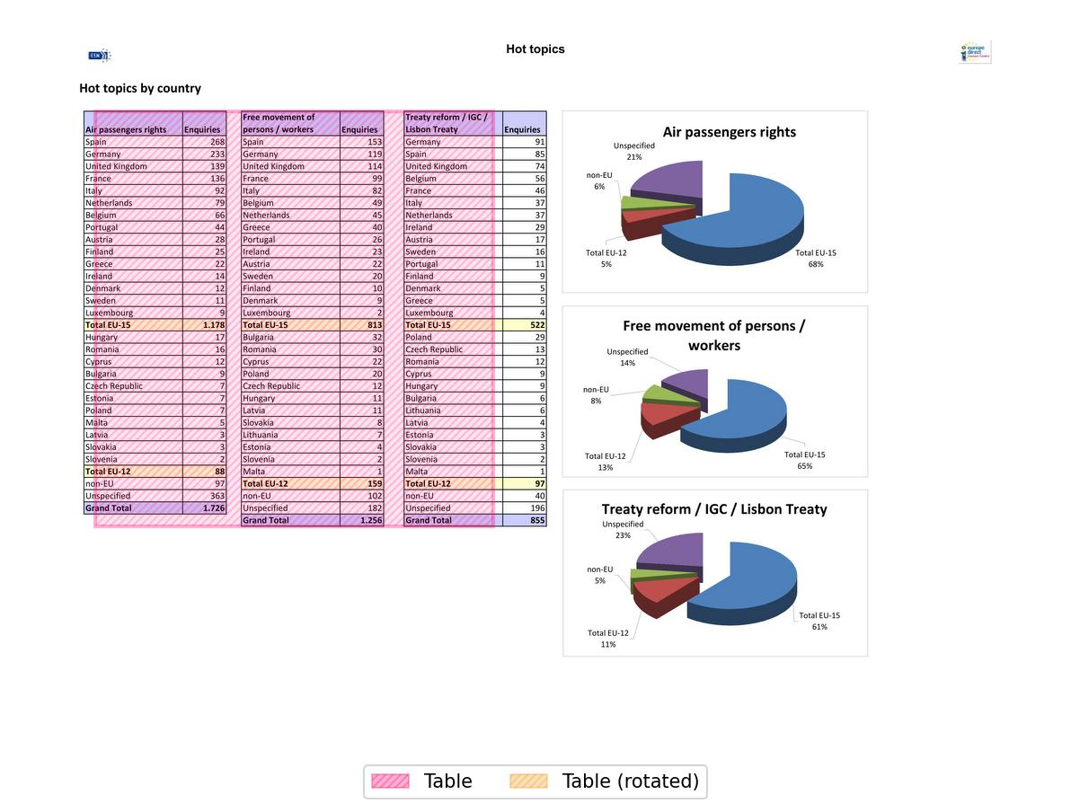
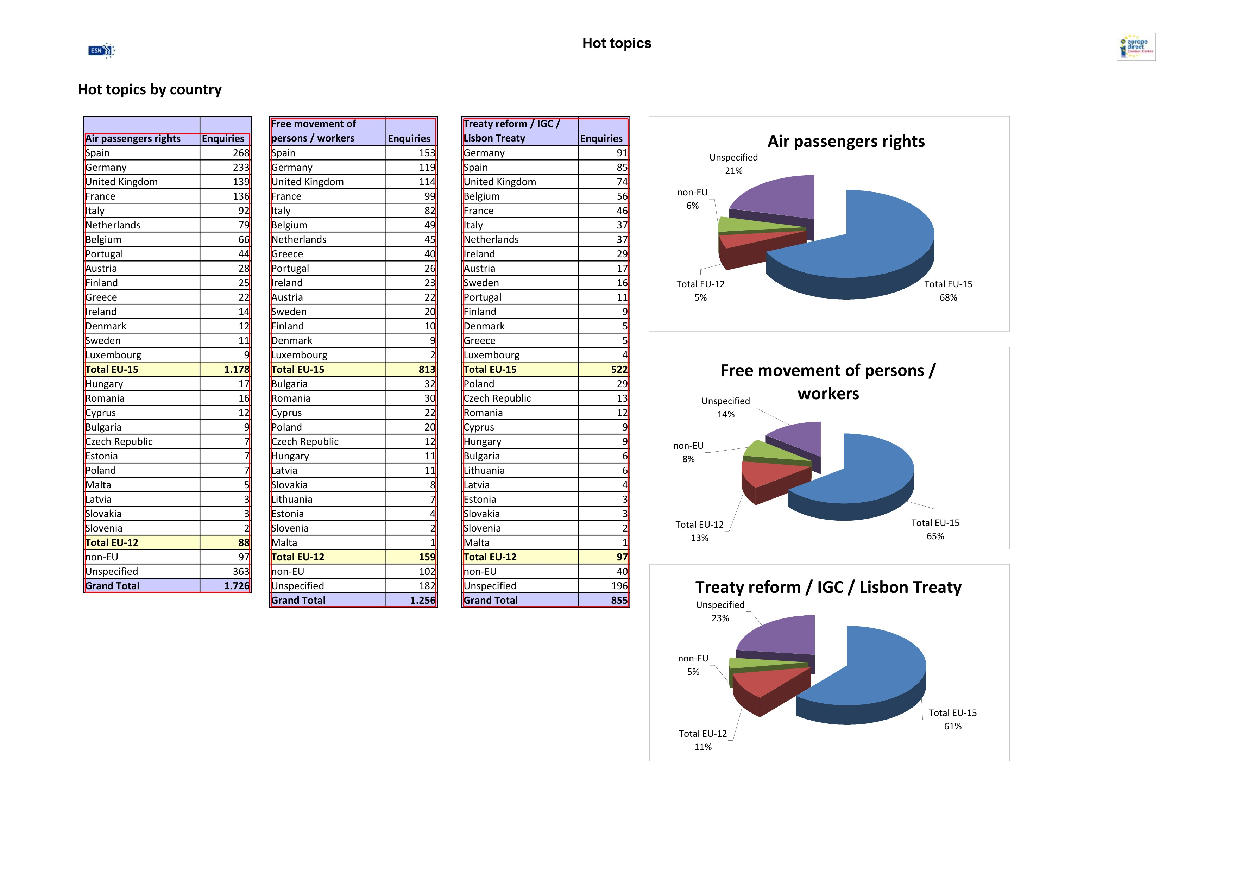
Errors of Score Group 00-10%
Ground truth
Prediction
TaTR detects wrong when the tables are too close to each other.
TaTR combines 3 tables into 1.

Slide 6
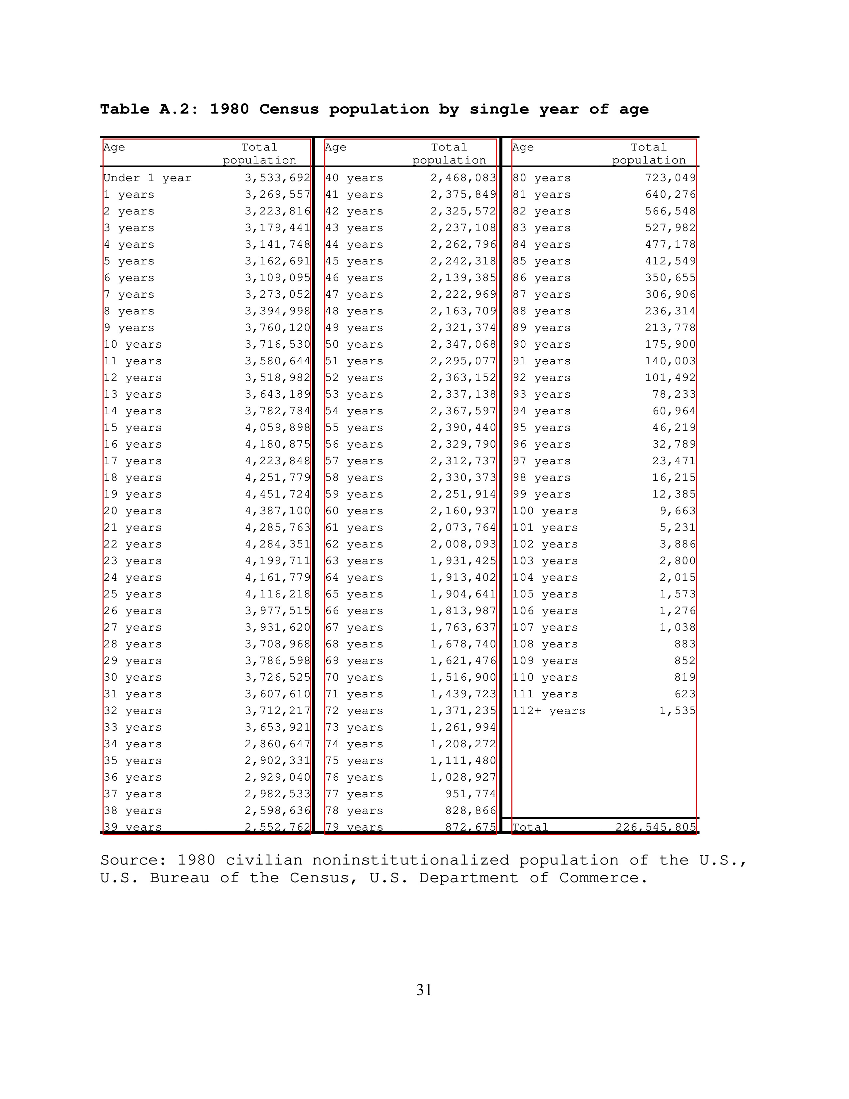
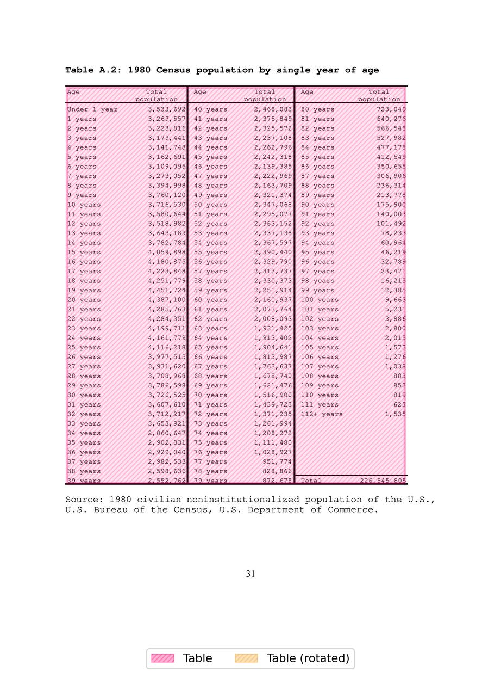
Errors of Score Group 10-20%
Ground truth
Prediction
TaTR cannot self-separate the tables when headers repeat.

Slide 7
TaTR Detection Results on ICDAR-2013
Errors Analysis – High Score Samples

Slide 8
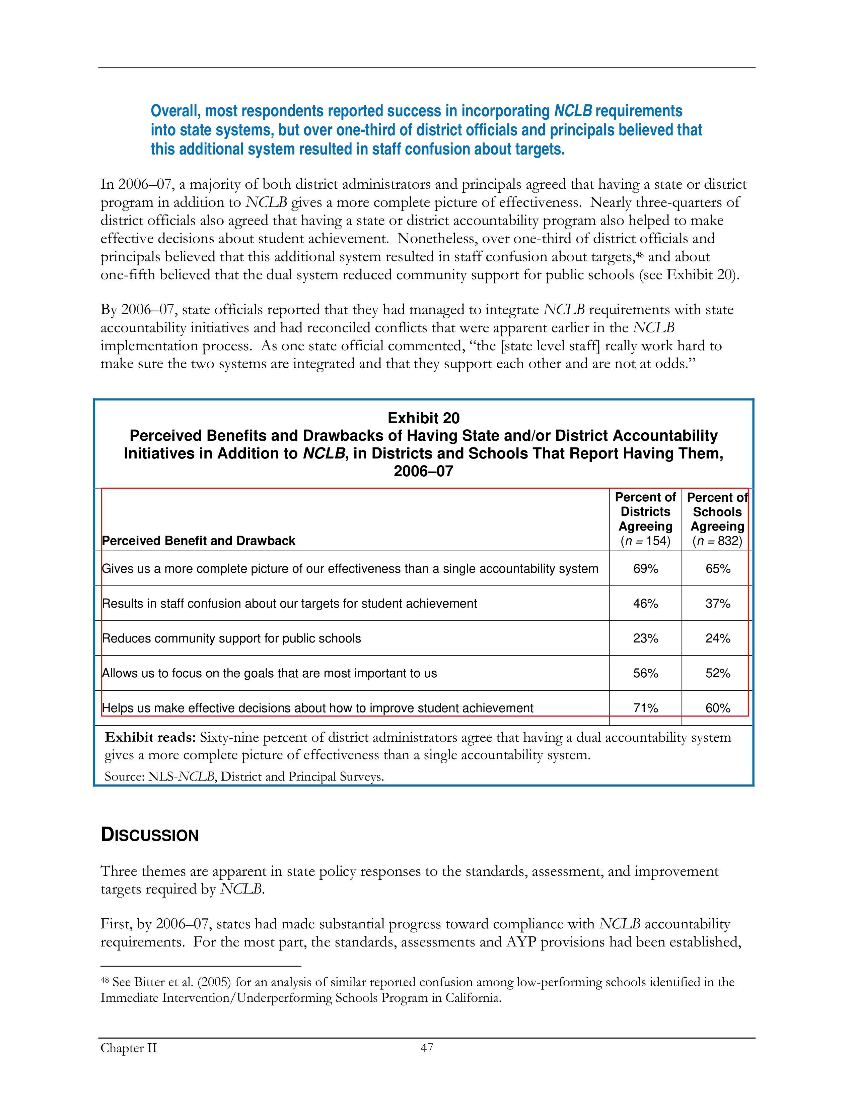
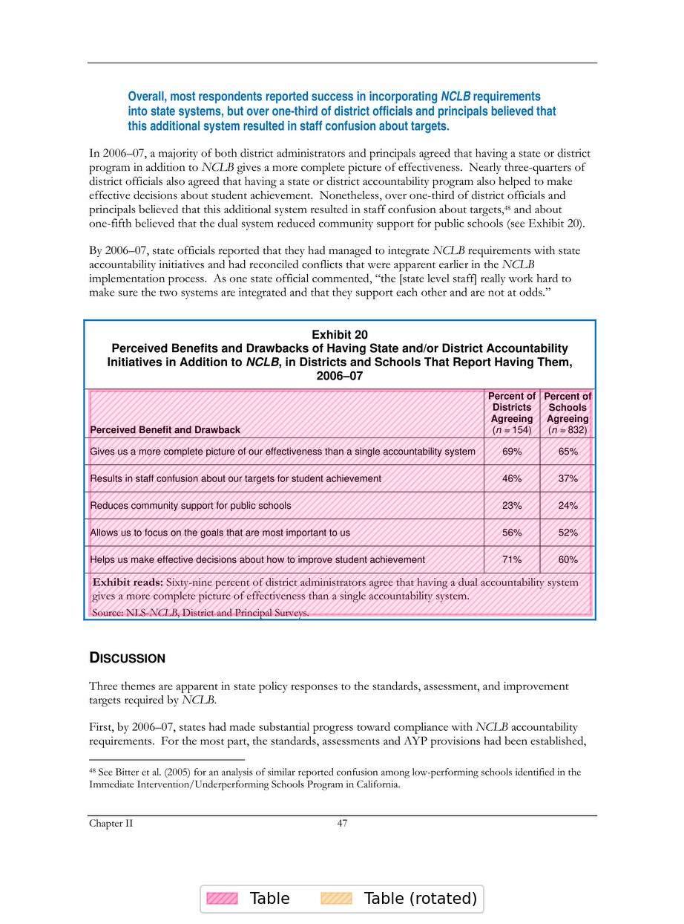
Errors of Score Group 70-80%
Ground truth
Prediction
TaTR detects tables base on position of text which leads to getting extra text

Slide 9
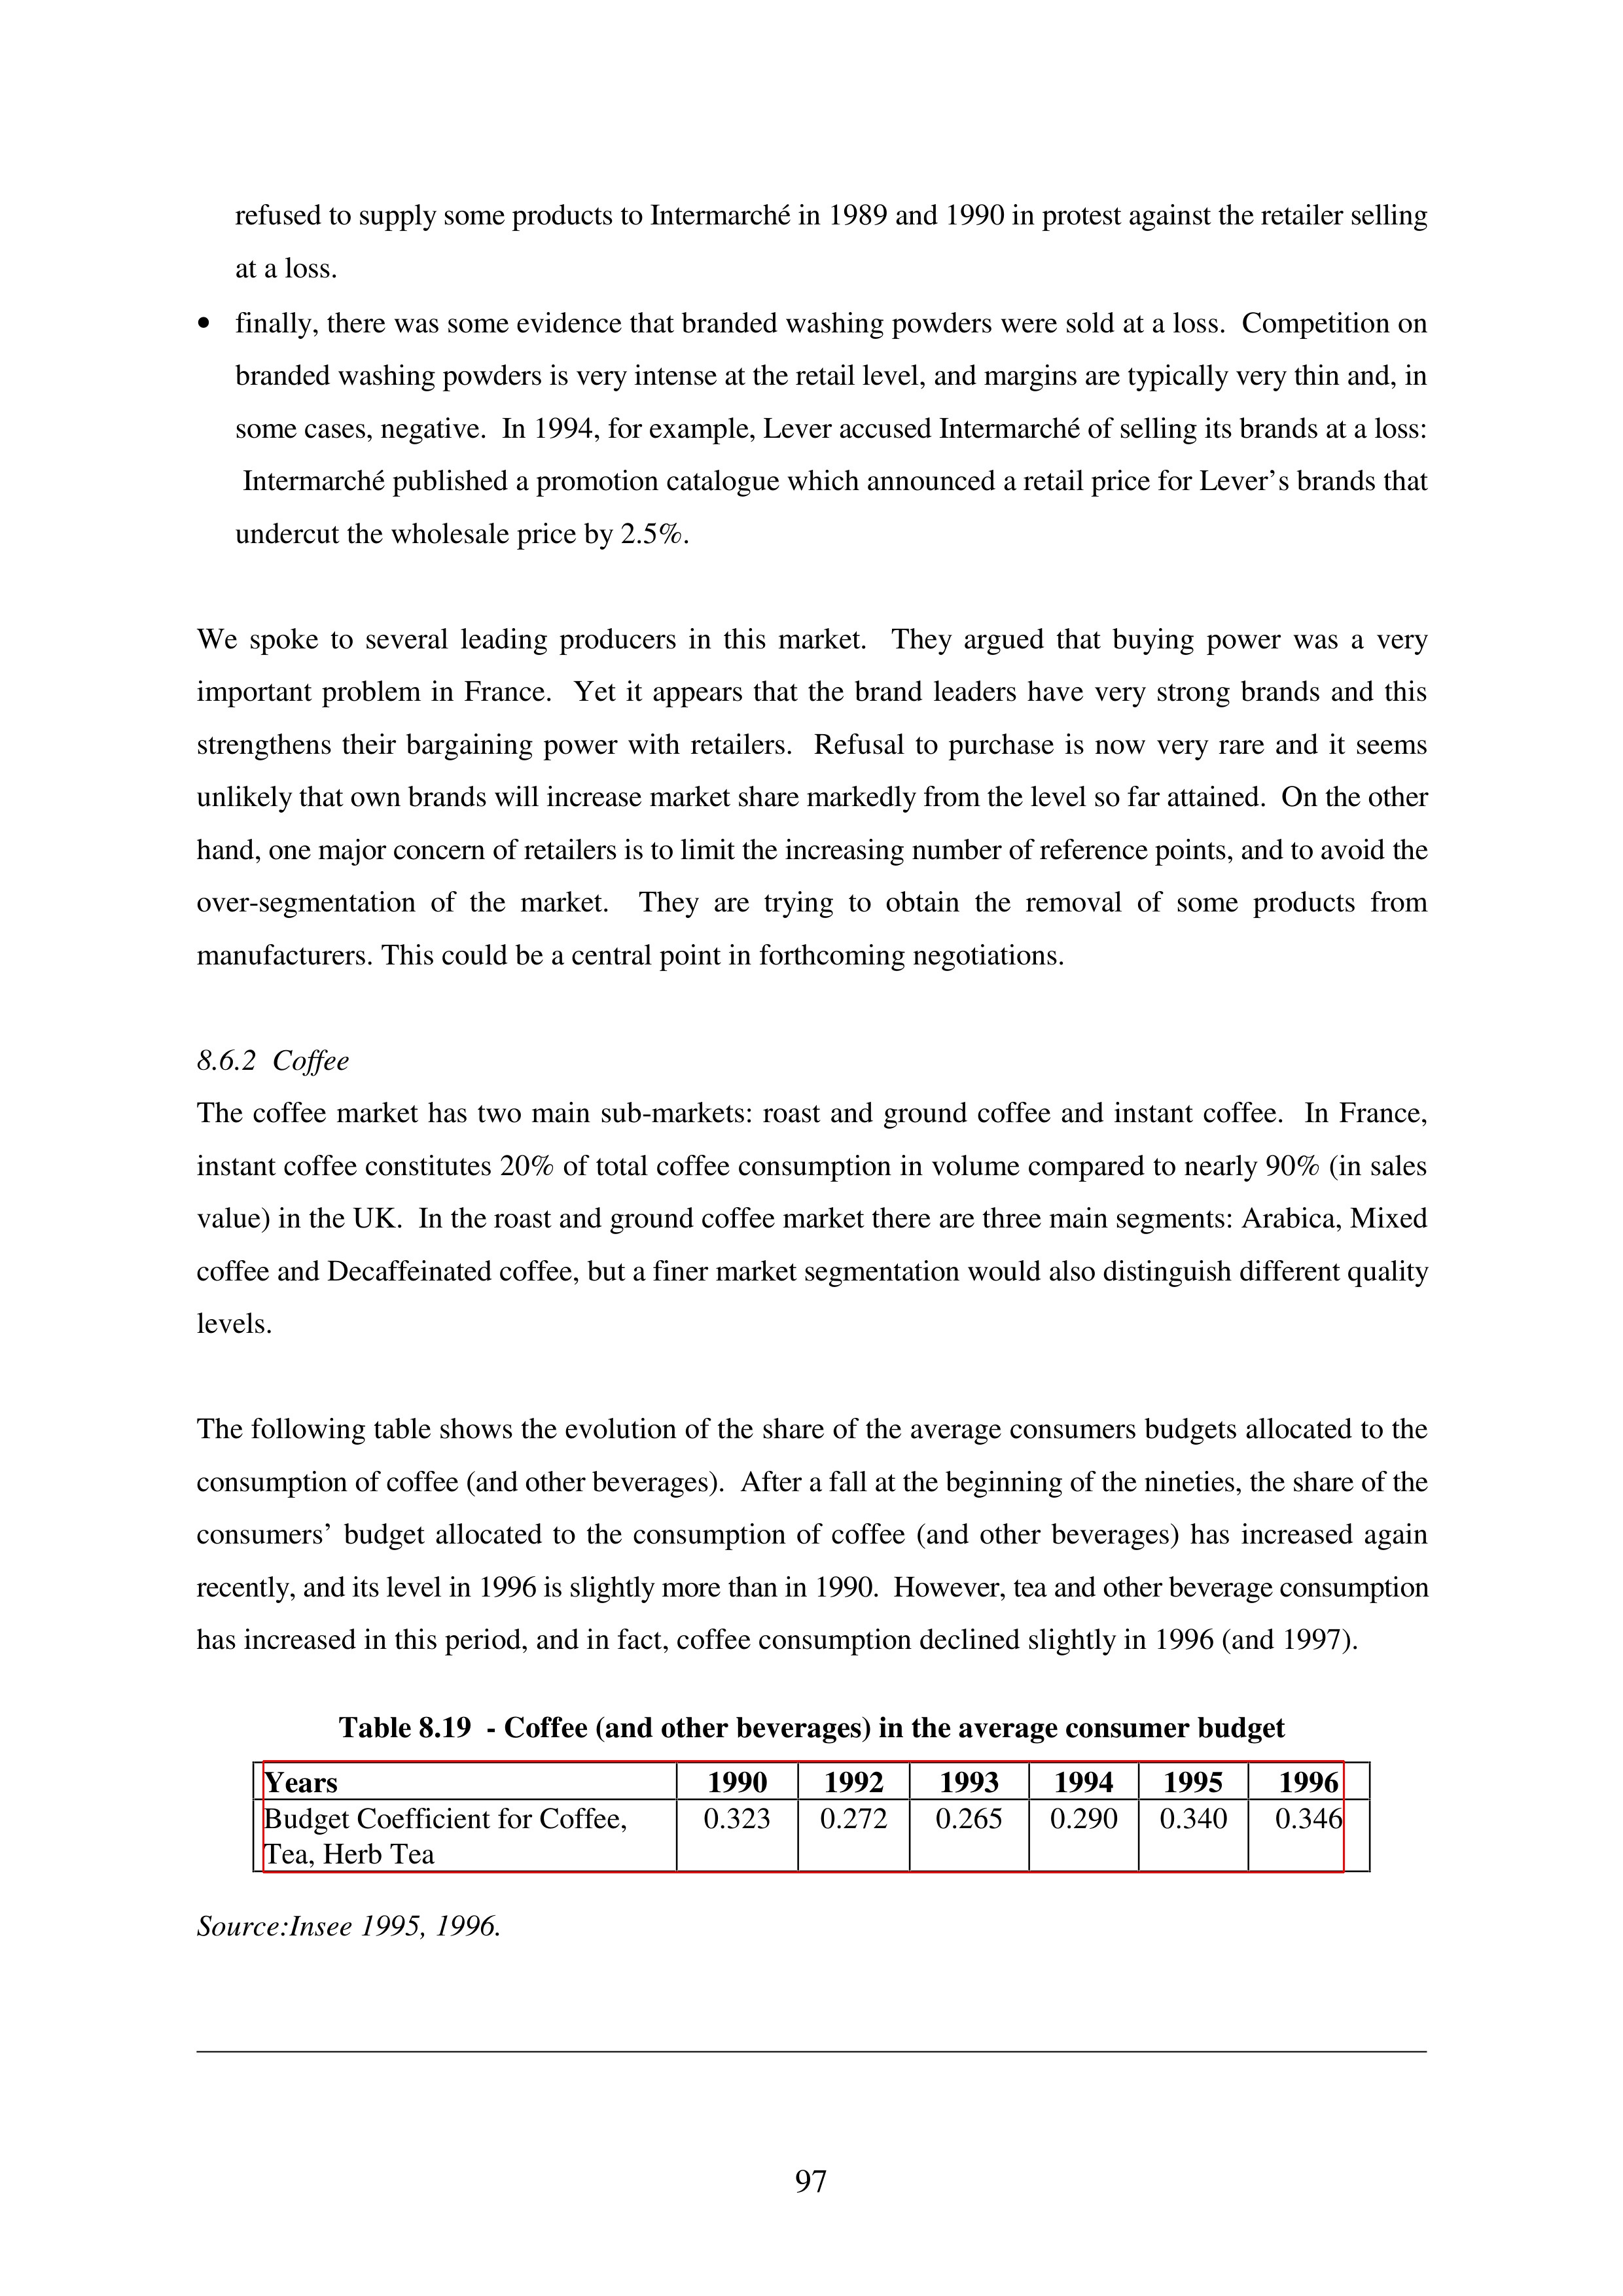
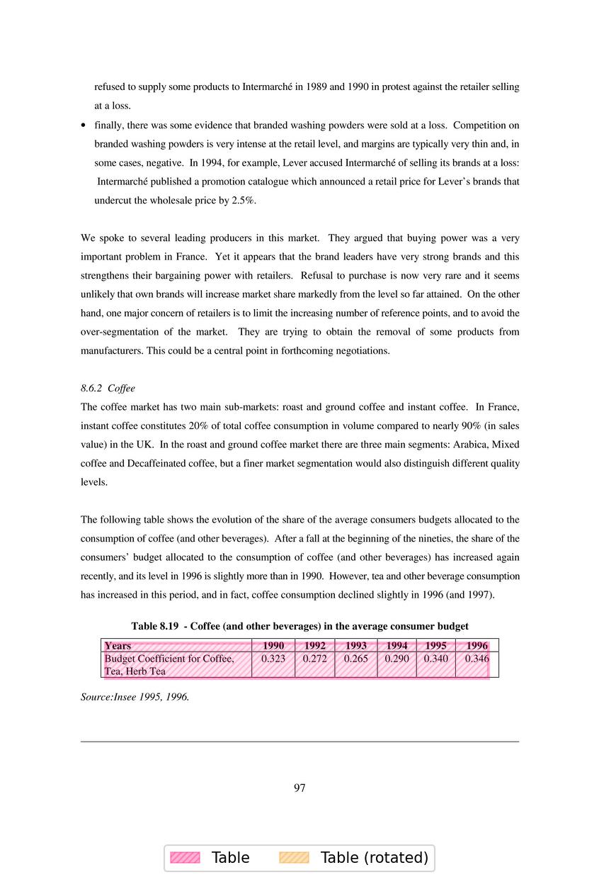
Errors of Score Group 80-100%
Ground Truth
Prediction
Can be count as perfect.

